Slide 1
Lecture 16
Data Science Intro

Slide 2
Learning Objectives Today
What is data science?
Data science life cycle
Impact of data science
Terminology
Use-cases
Kaggle Data Sets

Slide 3
Data Science
Data science is a field of study that includes domain expertise, programming skills, business acumen, mathematics and statistics knowledge to extract meaningful information to either solve problems or perform a certain task.
Data science is an interdisciplinary field that focuses on extracting knowledge and insights from structured and unstructured data. It combines principles and practices from various domains, including mathematics, statistics, computer science, and domain-specific knowledge, to analyze data and inform decision-making.

Slide 4
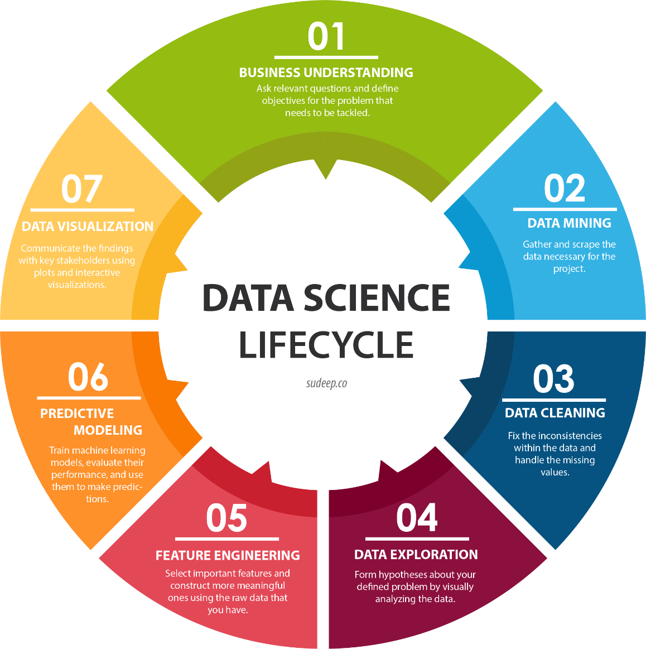
Data Science Life Cycle

Slide 5
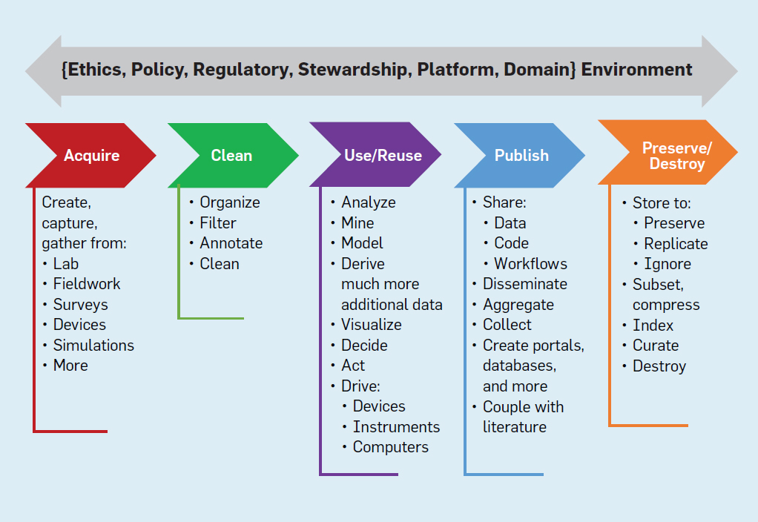
Data Science Life Cycle

Slide 6
Impact of Data Science
Business Decision-Making
Data-Driven Strategies: Data science enables organizations to make informed, quantifiable decisions by analyzing vast amounts of data. This leads to better forecasting, resource allocation, and strategic planning, ultimately enhancing operational efficiency and effectiveness.
Customer Insights: Through advanced analytics and natural language processing, businesses gain a deeper understanding of customer behavior and preferences. This allows for personalized marketing strategies and improved customer satisfaction, as companies can tailor their offerings to meet specific needs.
Sales Forecasting: Data science facilitates accurate sales predictions by analyzing historical data and market trends. This helps businesses adjust production and marketing strategies, preventing issues like overstocking or stockouts.

Slide 7
Impact of Data Science
Industry Transformations
Healthcare: In healthcare, data science is revolutionizing patient care by analyzing medical data for better diagnosis and treatment plans. Predictive analytics can identify at-risk patients and improve overall health outcomes.
Retail: Retailers utilize data science for customer segmentation, inventory management, and recommendation systems. This not only enhances customer experiences but also optimizes sales strategies and product offerings.
Finance: Financial institutions leverage data science for risk assessment, fraud detection, and investment strategies. By analyzing transaction patterns and market data, they can make more informed financial decisions and improve security measures.

Slide 8
Impact of Data Science
Operational Efficiency
Resource Optimization: Data science helps businesses allocate resources more effectively, identifying the most profitable marketing channels and optimizing advertising spend. This leads to a higher return on investment.
Automation and Efficiency: By automating data analysis and reporting processes, companies can focus on strategic tasks rather than manual data handling, thus increasing productivity.
Performance Measurement: Organizations can evaluate the effectiveness of their operations through robust metrics provided by data science. This continuous feedback loop helps refine strategies and improve performance over time.

Slide 9
Challenges
The costs associated with implementing data-driven technologies
Data privacy
Specialized skill
Ethical boundary
Compliance with regulations

Slide 10
Data Science Terminology
https://www.coursera.org/articles/data-science-terms
https://www.statcan.gc.ca/en/data-science/resources/terminology

Slide 11
What is data science used for?
Descriptive analysis
Diagnostic analysis
Predictive analysis
Prescriptive analysis

Slide 12
Descriptive analysis
Descriptive analysis examines data to gain insights into what happened or what is happening in the data environment. It is characterized by data visualizations such as pie charts, bar charts, line graphs, tables, or generated narratives. For example, a flight booking service may record data like the number of tickets booked each day. Descriptive analysis will reveal booking spikes, booking slumps, and high-performing months for this service.

Slide 13
Diagnostic analysis
Diagnostic analysis is a deep-dive or detailed data examination to understand why something happened. It is characterized by techniques such as drill-down, data discovery, data mining, and correlations. Multiple data operations and transformations may be performed on a given data set to discover unique patterns in each of these techniques.For example, the flight service might drill down on a particularly high-performing month to better understand the booking spike. This may lead to the discovery that many customers visit a particular city to attend a monthly sporting event.

Slide 14
Predictive analysis
Predictive analysis uses historical data to make accurate forecasts about data patterns that may occur in the future. It is characterized by techniques such as machine learning, forecasting, pattern matching, and predictive modeling. In each of these techniques, computers are trained to reverse engineer causality connections in the data.For example, the flight service team might use data science to predict flight booking patterns for the coming year at the start of each year. The computer program or algorithm may look at past data and predict booking spikes for certain destinations in May. Having anticipated their customer’s future travel requirements, the company could start targeted advertising for those cities from February.

Slide 15
Prescriptive analysis
Prescriptive analytics takes predictive data to the next level. It not only predicts what is likely to happen but also suggests an optimum response to that outcome. It can analyze the potential implications of different choices and recommend the best course of action. It uses graph analysis, simulation, complex event processing, neural networks, and recommendation engines from machine learning.
Back to the flight booking example, prescriptive analysis could look at historical marketing campaigns to maximize the advantage of the upcoming booking spike. A data scientist could project booking outcomes for different levels of marketing spend on various marketing channels. These data forecasts would give the flight booking company greater confidence in their marketing decisions.

Slide 16
More Scenarios
E-commerce Site
Understanding unstructured addresses
Relevant Advertisement
Product search based on relevance

Slide 17
More Scenarios
Streaming Platform
Reason for living
Engaging content
Area-wise content distribution

Slide 18
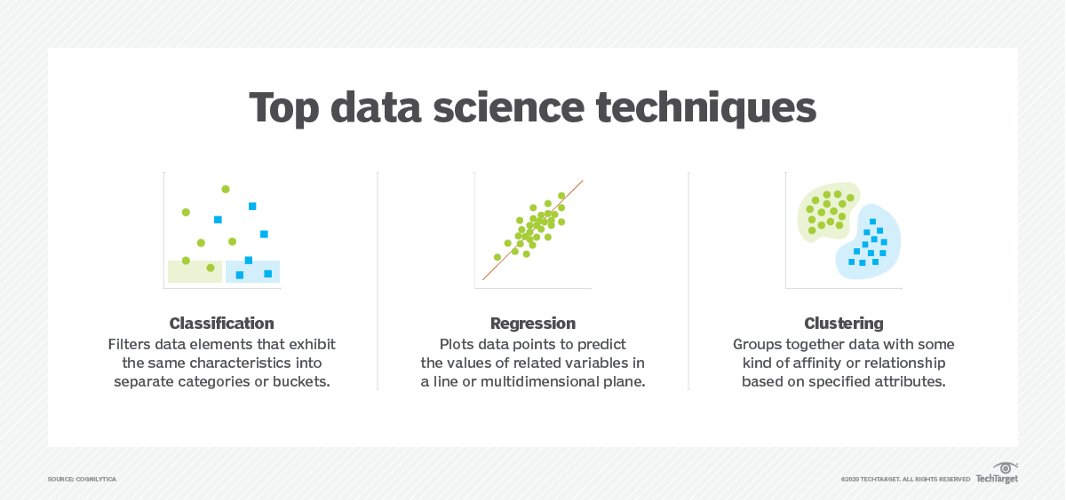
Techniques

Slide 19
Classification
Classification is the sorting of data into specific groups or categories. Computers are trained to identify and sort data. Known data sets are used to build decision algorithms in a computer that quickly processes and categorizes the data. For example:·
Sort products as popular or not popular·
Sort insurance applications as high risk or low risk·
Sort social media comments into positive, negative, or neutral.
Data science professionals use computing systems to follow the data science process.

Slide 20
Regression
Regression is the method of finding a relationship between two seemingly unrelated data points. The connection is usually modeled around a mathematical formula and represented as a graph or curves. When the value of one data point is known, regression is used to predict the other data point. For example:·
The rate of spread of air-borne diseases.·
The relationship between customer satisfaction and the number of employees.·
The relationship between the number of fire stations and the number of injuries due to fire in a particular location.

Slide 21
Clustering
Clustering is the method of grouping closely related data together to look for patterns and anomalies. Clustering is different from sorting because the data cannot be accurately classified into fixed categories. Hence the data is grouped into most likely relationships. New patterns and relationships can be discovered with clustering. For example: ·
Group customers with similar purchase behavior for improved customer service.·
Group network traffic to identify daily usage patterns and identify a network attack faster.
Cluster articles into multiple different news categories and use this information to find fake news content.

Slide 22
More Techniques
Natural Language Processing (NLP)
Dimensionality Reduction
A/B Testing
Supervised
Unsupervised
Semi-supervised

Slide 23
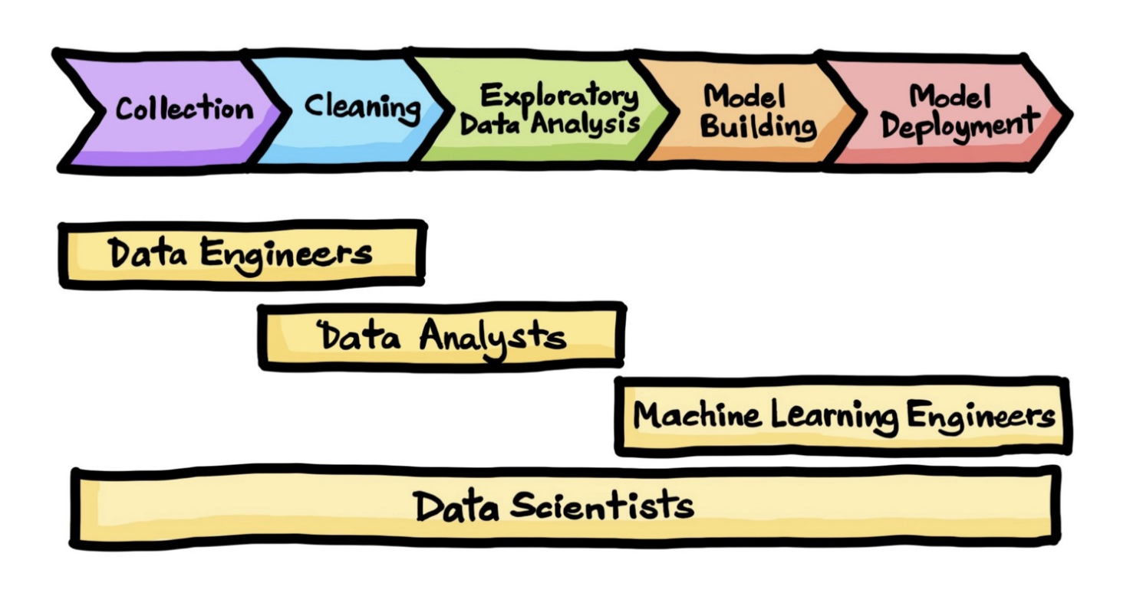
So What is Data Science?

Slide 24
Kaggle
Kaggle is a prominent platform for data science and machine learning, serving as both a competition site and a collaborative community. Founded in April 2010 by Anthony Goldbloom, Kaggle has grown to become the largest data science community globally, with over 15 million users across 194 countries as of October 2023. Google acquired Kaggle in 2017, integrating it into Google Cloud services
Key Features:
Competitions
Datasets and Notebooks
Community and Learning
Research and Development

Slide 25
Kaggle Datasets
Sample
https://www.kaggle.com/datasets/abdullah0a/social-media-sentiment-analysis-dataset?resource=download
https://www.kaggle.com/datasets/shashanks1202/apartment-rent-data?select=apartments_for_rent_classified_10K
Code Available?

